Slide 1
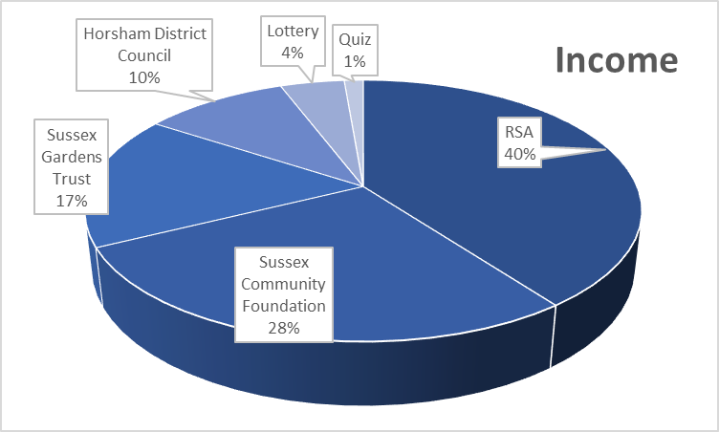
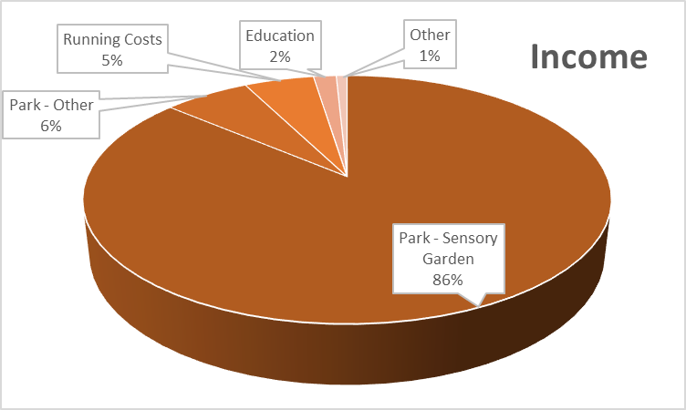
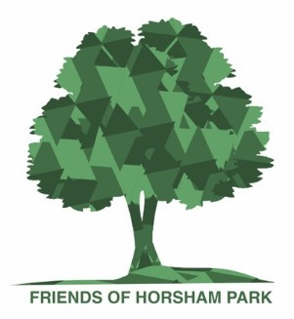
 | 2021 | 2020
Grants & Donations
RSA | 5,000
Sussex Community Foundation | 3,500
Horsham District Council | 2,082
Sussex Gardens Trust | 1,258
Other | - | 1,480
Sub total for grants | 11,840 | 1,480
Horsham Lottery | 558 | 606
Quiz Income | 166 | 812
Other | - | 192
TOTAL | 12,564 | 3,090
Financials
September 2020
to
August 2021
Assets |  | 12,053
Liabilities |  | 10,875
Grants carried forward | 10,040
Company Costs | 250
Other | 585
Net Assets |  | 1,178
Brought Forward | 2,350
Contribution | - 1,172
Total |  | 1,178
 | 2021 | 2020
Income | 12,564 | 3,090
Expenditure | 13,736 | 1,474
Profit / Loss | - 1,172 | 1,616
 | 2021 | 2020
Park Expenditure - Sensory Garden
Grants spent | 1,800
Grants carried forward | 10,040
Park Expenditure - Other
Volunteer Spend | 500 | 300
Other | 361 | 480
Total Park Expenditure | 12,701 | 780
Education | 229
Insurance | 404 | 442
Company Costs | 294 | 213
Events | 37 | 214
Other / reserve releases | 72 | - 175
TOTAL | 13,736 | 1,474

